Slide 1
DATA STRUCTURES
List ADT

Slide 2
Session Objectives
To learn about the basics of Abstract Data Type (ADT)
Notes:
Student Notes:
The objective of the session is to introduce the concept of services and how these are management. There are standards and frameworks that enable the organization to manage the services. These are also introduced in this session.

Slide 3
Session Outcomes
At the end of this session, participants will be able to
Understand the basics of List ADT
Write his own ADT

Slide 4
Agenda
Data members and operations of List ADT
Implementation of List ADT using Array
Implementation of List ADT using Linked List

Slide 5

List ADT
Dr. B. Prabavathy
SSNCE

Slide 6
What is ADT?
Abstract Data type (ADT)
Type (or class) for objects whose behaviour is defined by a set of value and a set of operations
Definition of ADT
only mentions what operations are to be performed but not how these operations will be implemented
Does not specify
how data will be organized in memory and
what algorithms will be used for implementing the operations
Called “abstract” because
it gives an implementation independent view
Process of providing
only the essentials and hiding the details is known as abstraction

Slide 7
What is ADT?
Every ADT has a way to
Insert
Delete
Access or Retrieve
Find
Simplest ADT is a Bag
items can be added, removed, accessed
no implied order to the items
duplicates allowed

Slide 8
List ADT
A sequence of zero or more elements
A₁, A₂, A₃, … A_{N}
N → length of the list
A₁ → first element
A_{N} →last element
A_{i} → ith element
If N=0, then it is empty list
List is linearly ordered due to the following
A_{i} precedes A_{i+1}
A_{i} follows A_{i-1}

Slide 9
Operations in the List
printList: print the list
makeEmpty: create an empty list
find: locate the position of an object in a list
list: 34,12, 52, 16, 12
find(52) → 3
insert: insert an object to a list
insert(x,3) → 34, 12, 52, x, 16, 12
remove: delete an element from the list
remove(52) → 34, 12, x, 16, 12
findKth: retrieve the element at a certain position

Slide 10
Implementation of List ADT
Two standard implementations for the list ADT
Array-based
Linked list

Slide 11
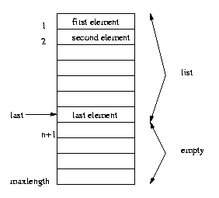
Array Implementation
Elements are stored in contiguous array positions
Requires an estimate of the maximum size of the list
waste space
printList and find: O(n)
findKth: O(1)
insert and delete: O(n)
e.g. insert at position 0 (making a new element)
requires first pushing the entire array down one spot to make room
e.g. delete at position 0
requires shifting all the elements in the list up one
On average, half of the lists needs to be moved for either operation

Slide 12
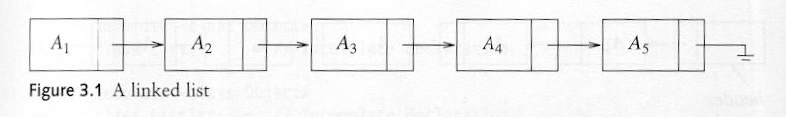
Pointer Implementation (Linked List)
Ensure that the list is not stored contiguously
use a linked list
a series of structures that are not necessarily adjacent in memory
Each node contains the element and a pointer to a structure containing its successor
the last cell’s next link points to NULL
Compared to the array implementation,
the pointer implementation uses only as much space as is needed for the elements currently on the list
but requires space for the pointers in each cell

Slide 13
Linked List
A linked list is a series of connected nodes
Each node contains at least
A piece of data (any type)
Pointer to the next node in the list
Head: pointer to the first node
The last node points to NULL
A
B
C
∅
node
A
data
pointer
13

Slide 14
Linked List Implementation
Requires no estimate of the maximum size of the list
No space will be wasted
printList and find: O(n)
findKth: O(n)
insert and delete: O(1)
e.g. insert at position 0 (making a new element)
Insert does not require moving the other elements
e.g. delete at position 0
requires no shifting of elements
Insertion and deletion becomes easier, but finding the Kth element moves from O(1) to O(n)

Slide 15
Variations of Linked Lists
Circular linked lists
The last node points to the first node of the list
A
B
C
Head

Slide 16
Variations of Linked Lists
Doubly linked lists
Each node points to not only successor but the predecessor
There are two NULL: at the first and last nodes in the list
Advantage: given a node, it is easy to visit its predecessor. Convenient to traverse lists backwards
∅
A
B
C
∅
Head

Slide 17
Array versus Linked Lists
Linked lists are more complex to code and manage than arrays, but they have some distinct advantages.
Dynamic: a linked list can easily grow and shrink in size.
We don’t need to know how many nodes will be in the list. They are created in memory as needed.
In contrast, the size of a C array is fixed at compilation time.
Easy and fast insertions and deletions
To insert or delete an element in an array, we need to copy to temporary variables to make room for new elements or close the gap caused by deleted elements.
With a linked list, no need to move other nodes. Only need to reset some pointers.

Slide 18
Simple Questions
What are the ways in which the lists can be implemented?
What complexity is involved for insertion and deletion operations for the array and liked list implementation of lists?
What are the variations of linked list implementation?

Slide 19
Summary
Basic operations of List ADT
Implementation of List ADT using Array and Linked List

